Slide 1
Visual Analysis
What it is, What it’s not.

Slide 2
Analysis means Interpretation
I analyze someone’s body movements to interpret his/her mood.
I analyze a piece of literature to interpret a meaning that is not immediately apparent.
I analyze someone’s dream to interpret his psychological fixation on his mother.

Slide 3
Analysis Does Not Mean…
Describing
Describing (That student is rubbing her hands together.)
Reporting
Reporting (I counted twenty uses of the color red in the novel.)
Stating
Stating the obvious (Your dream was about a dove carrying you back to your mother.)

Slide 4
So your analysis…
Is your interpretation, your opinion about how to read the details (My colleague looks at the same student and thinks the hand rubbing means she is excited; I think she is nervous. Now, we need to defend and support our separate conclusions.)
Is debatable (see above)
Requires support
Requires explanation

Slide 5


Slide 6


Slide 7
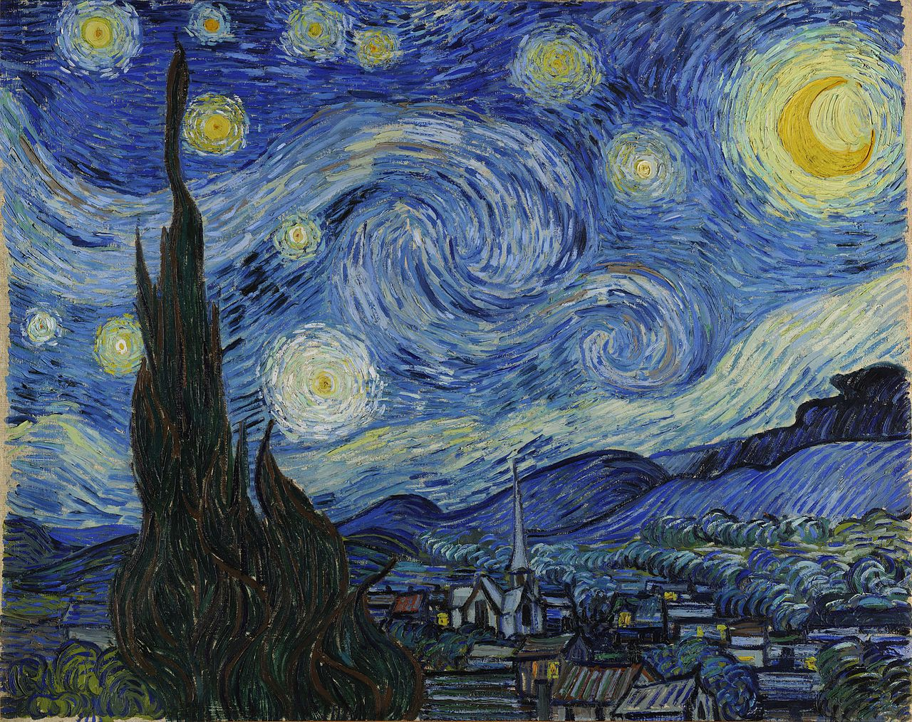

Slide 8

How Much Detail Do you Notice?

Slide 9
This much? (From reed.edu)
The ads featuring both male and female athlete, on the other hand, are far more problematic, and reveal the issues of battle, domination, and sexualization underlying the text and strategy. The runners’ bodies are positioned in an erotically-charged manner, hips almost touching. The man turns completely away from the camera, staring overtly at his competition. The viewer is left to determine the meaning of this gaze. Is he flirting with her? Egging her on? Pursuing her against her wishes? Several physical indicators seem to imply the existence of a an aggressive and sexual underpinning. The woman’s facial expression, for example, though similar to her individual photo, has changed. Her lips have drawn down, as if worried, whereas before her face was smooth and relaxed. Additionally, she does not return the man’s gaze, and does not seem to be enjoying his pursuit. These indicators are complicated further by the man’s overt dominance. He is featured at the center of the ad, both in front of and taller than the woman’s body. His right hand is constricted strongly, as if grasping an invisible object – a gesture invoking strength – while his left still offers a vigorous thumbs-up. The woman’s fingers, however, have curled inwards, giving her a far less agentive look.

